Slide 1
Project Presentation of Industry Oriented Hands on Experience (22CS422)
On
Performance Analysis of JVM Garbage Collectors
Priyanshi Jain | jpriya1530@gmail.com
Rakshita | rakshitabhardwaj23@gmail.com
Taniya | goyaltaniya40@gmail.com
Divyanjali Singla | divyanjalisingla@gmail.com
Supervised By
Dr. Rajat Takkar
Department of Computer Science and Engineering,
Chitkara University, Punjab

Slide 2
Introduction
Memory management is a key element of modern software systems, especially those running on the Java Virtual Machine (JVM). Garbage Collection (GC) automatically reclaims unused memory, mitigating memory leaks and reducing the need for manual memory management.
The JVM offers multiple GC algorithms, each with different trade-offs in latency, throughput, and memory efficiency. This research presents a comparative study of Serial GC, Parallel GC, G1 GC, ZGC, and Shenandoah under memory-intensive workloads.
Key findings show that modern concurrent collectors (ZGC and Shenandoah) drastically reduce pause times, making them ideal for real-time and large-scale applications. G1 GC strikes a balance between throughput and latency, while Serial and Parallel GC exhibit limitations under heavy loads.

Slide 3
Literature Review
Key Prior Research
Dashti & Fedorova (2020): GPU-based GC offers no significant benefit due to memory bandwidth limitations.
Kolokasis et al. (2021): TeraHeap reduces GC overhead in big data systems but requires JVM adjustments.
Zhao et al. (2022): Parallel GC improves throughput and reduces pause time but adds system complexity.
Islam et al. (2023): ZGC shows low pause times vs. Serial GC high latency using big data benchmarks.
Chen et al. (2024): GC optimizations for ML applications improve responsiveness but add compute cost.
Research Gaps
Synthetic benchmarks: Most studies use artificial workloads, limiting real-world applicability.
No universal selector: No automated method exists to choose the best GC per application type.
ML-based methods: Introduce overhead and remain unreliable for production systems.

Slide 4
System Architecture
Four-Layer Modular Architecture
Workload Generation Layer: Memory-intensive workloads using DaCapo benchmarking suite and custom stress applications simulating real-world scenarios.
JVM Execution Layer: Runs workloads with Serial GC, Parallel GC, G1 GC, ZGC, and Shenandoah configured with standardized heap sizes and JVM settings.
Monitoring Module: Collects runtime statistics including heap usage, GC pause time, CPU consumption, and throughput using JVisualVM and JConsole.
Analysis & Evaluation Engine: Processes collected data to compute performance metrics, identify trade-offs, and generate comparative reports for GC selection.
System Workflow
Workflow: Workload Input → JVM Execution → GC → Monitoring → Data Collection → Analysis → Results

Slide 5
Methodology
Experimental Setup
Hardware: Multi-core system running standard JVM; heap fixed at -Xms2g -Xmx2g.
Collectors Tested: Serial GC, Parallel GC, G1 GC, ZGC, Shenandoah — identical system settings.
Workload: 5 warm-up rounds + 15 measured rounds; 120 outer loops, 80 inner allocations, 256 KB block size.
Performance Metrics
Throughput (%): Percentage of time application runs without GC pauses.
Avg Pause Time (ms): Mean stop-the-world duration per GC collection cycle.
CPU Usage (%): Processor overhead consumed by GC operations per round.
Memory Before/After (MB): Heap usage before and after each GC cycle.
GC Count and GC Time: Number of collection events and cumulative collection time per round.

Slide 6
Implementation
Development Environment
Language/Platform: Java on JVM — supports Serial, Parallel, G1, ZGC, and Shenandoah collectors.
Benchmark Program: Custom GCResearchBenchmark.java — measures exec time, pause, throughput, CPU, GC stats.
Key Components
captureGCStats(): Uses ManagementFactory.getGarbageCollectorMXBeans() to track GC count and time delta per round.
getProcessCpuTimeNs(): Reads process CPU time via com.sun.management.OperatingSystemMXBean.
printSummary(): Computes avg/min/max exec time, avg pause, throughput, CPU, GC stats across all rounds.
Run Commands (Examples)
G1 GC: java -Xms2g -Xmx2g -XX:+UseG1GC GCResearchBenchmark
Serial GC: java -Xms2g -Xmx2g -XX:+UseSerialGC GCResearchBenchmark
Parallel GC: java -Xms2g -Xmx2g -XX:+UseParallelGC GCResearchBenchmark

Slide 7
Code Implementation
Code Structure Overview
printSummary() (lines 224-254): Accumulates exec time, pause, throughput, CPU, memory, GC stats; tracks min/max exec times.
captureGCStats() (lines 138-155): Queries all GarbageCollectorMXBean instances to get total GC collection count and time in ms.
getProcessCpuTimeNs() (lines 158-166): Casts OperatingSystemMXBean to sun flavor; retrieves per-process CPU time in nanoseconds.
Output Fields Per Round
Core metrics: Execution Time, Avg Pause Time, Throughput (%) — primary latency and throughput data.
Resource metrics: CPU Usage %, GC Count Delta, GC Time Delta — overhead measurement.
Memory metrics: Memory Before and After (MB), Checksum — heap behavior and correctness.

Slide 8
.
Performance Results
G1 GC Final Summary (Measured Benchmark)
Avg Exec Time: 499.93ms | Min: 227ms | Max: 947ms across 15 rounds.
Avg Pause Time: 5.08ms | Throughput: 95.07% | CPU Usage: 4.78%
GC Stats: Avg GC Time: 22.27ms | Avg GC Count: 4.40 | Avg Mem Before: 378.85MB | After: 365.74MB
Comparative Summary (from Research)
Serial GC: Avg Pause ~120ms | Throughput ~70% | CPU ~40% — single-threaded, simple workloads.
Parallel GC: Avg Pause ~95ms | Throughput ~82% | CPU ~75% — multi-threaded batch processing.
G1 GC: Avg Pause ~45ms | Throughput ~88% | CPU ~68% — best general-purpose balance.
ZGC: Avg Pause ~12ms | Throughput ~91% | CPU ~82% — ultra-low latency concurrent.
Shenandoah: Avg Pause ~18ms | Throughput ~89% | CPU ~80% — low latency concurrent.

Slide 9
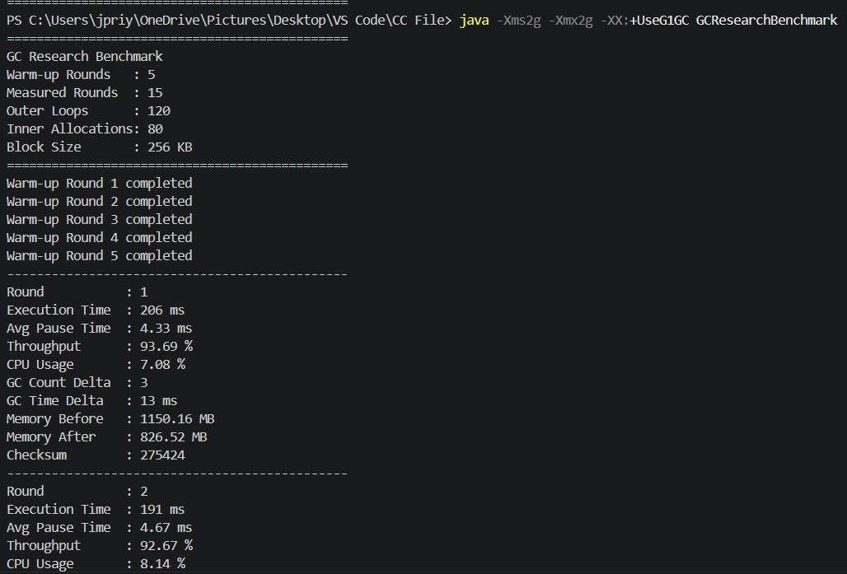
G1 GC — Benchmark Output
G1 GC run with -XX:+UseG1GC | Heap: -Xms2g -Xmx2g | 5 warm-up + 15 measured rounds

Slide 10
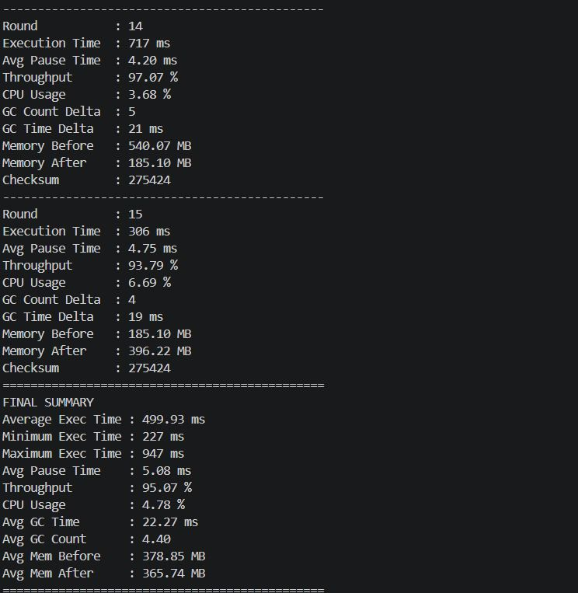
Parallel GC — Benchmark Output
Parallel GC run with -XX:+UseParallelGC | Heap: -Xms2g -Xmx2g | 5 warm-up + 15 measured rounds

Slide 11
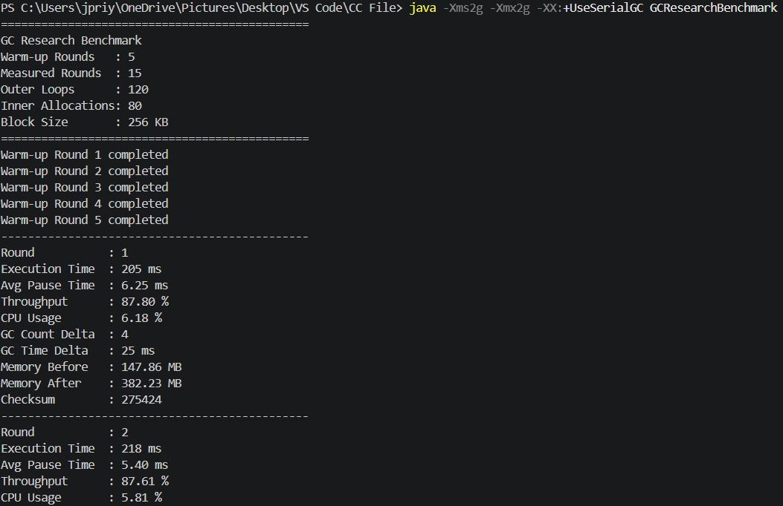
Serial GC — Benchmark Output

Slide 12
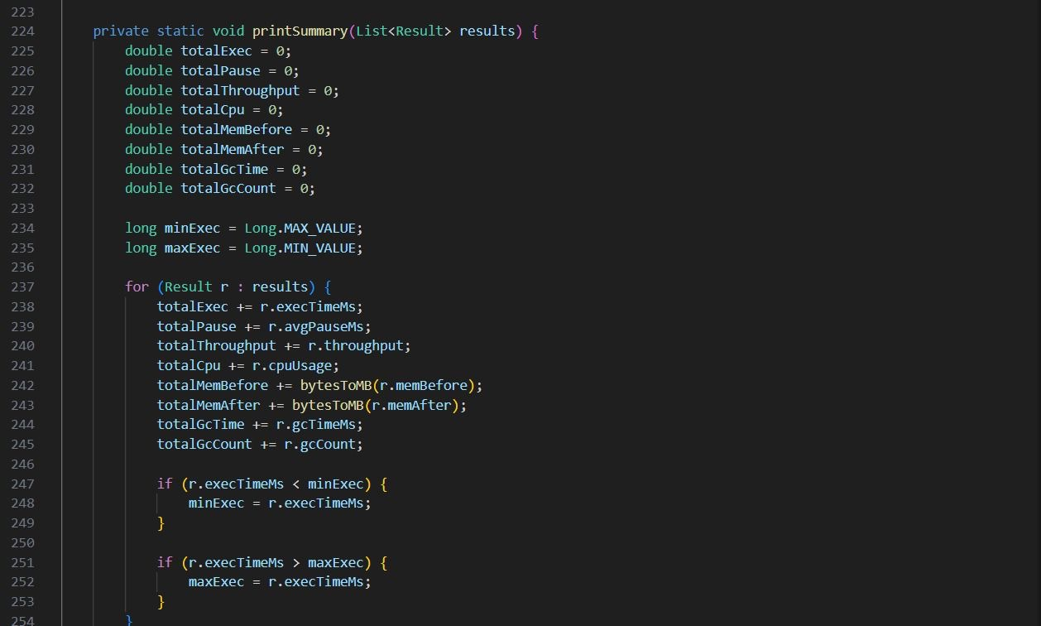
printSummary() Method
printSummary() iterates Result list: accumulates exec, pause, throughput, CPU, memory, GC stats; tracks min/max exec time.

Slide 13
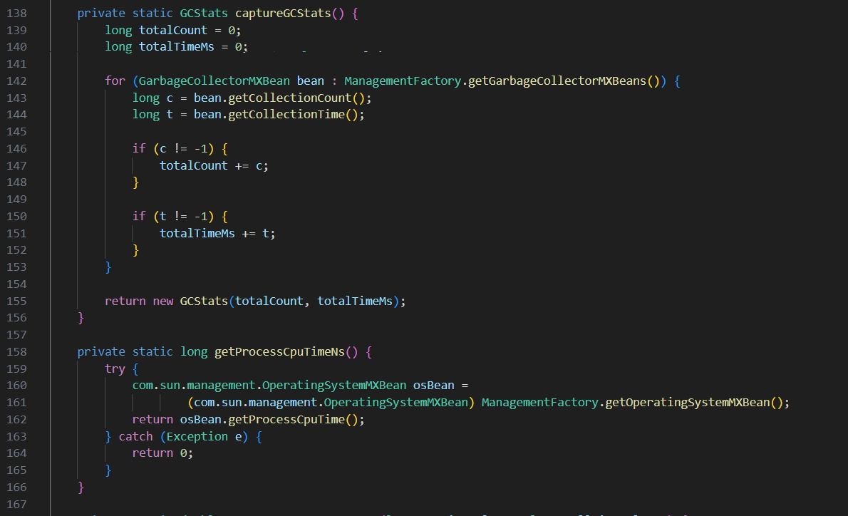
captureGCStats() Method
captureGCStats() queries GarbageCollectorMXBeans to compute total GC collection count and total collection time in ms.

Slide 14
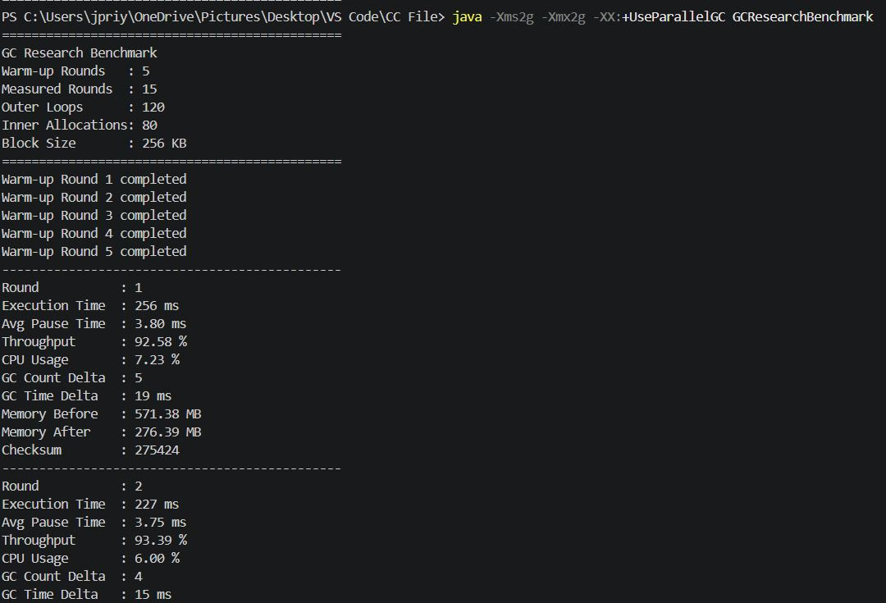
G1 GC — Final Summary Output

Slide 15
Thank You

